Slide 1
High Performance Python Lab Term 2 2019/2020
Lecture 3

Slide 2
Outline
Memory hierarchy
Building intuition: parallel processes
Amdahl‘s law, Gustafson's law
Strong and weak scallabilities
Flynn‘s taxonomy
Shared memory and distributed memory systems
Processes and threads
Start with profiling in python

Slide 3
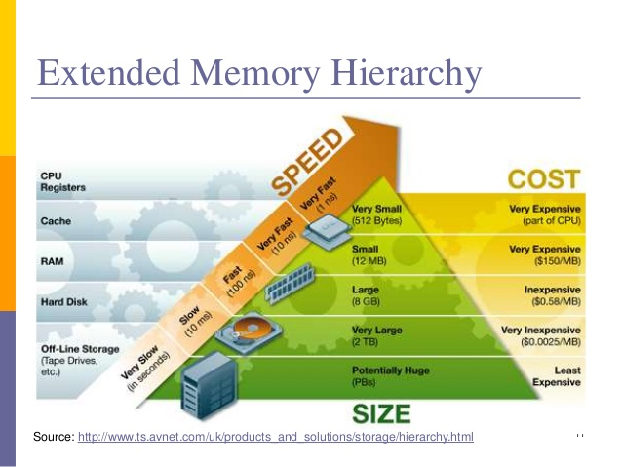

Slide 4
Parallel intuition
Examples of parallelism in real world?

Slide 5
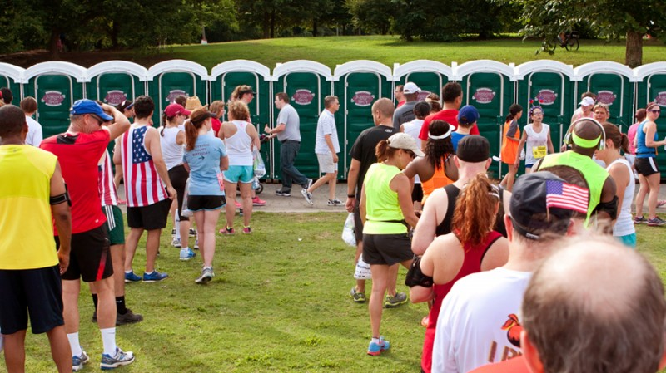
Parallel intuition How to really understand concurrency.

Slide 6
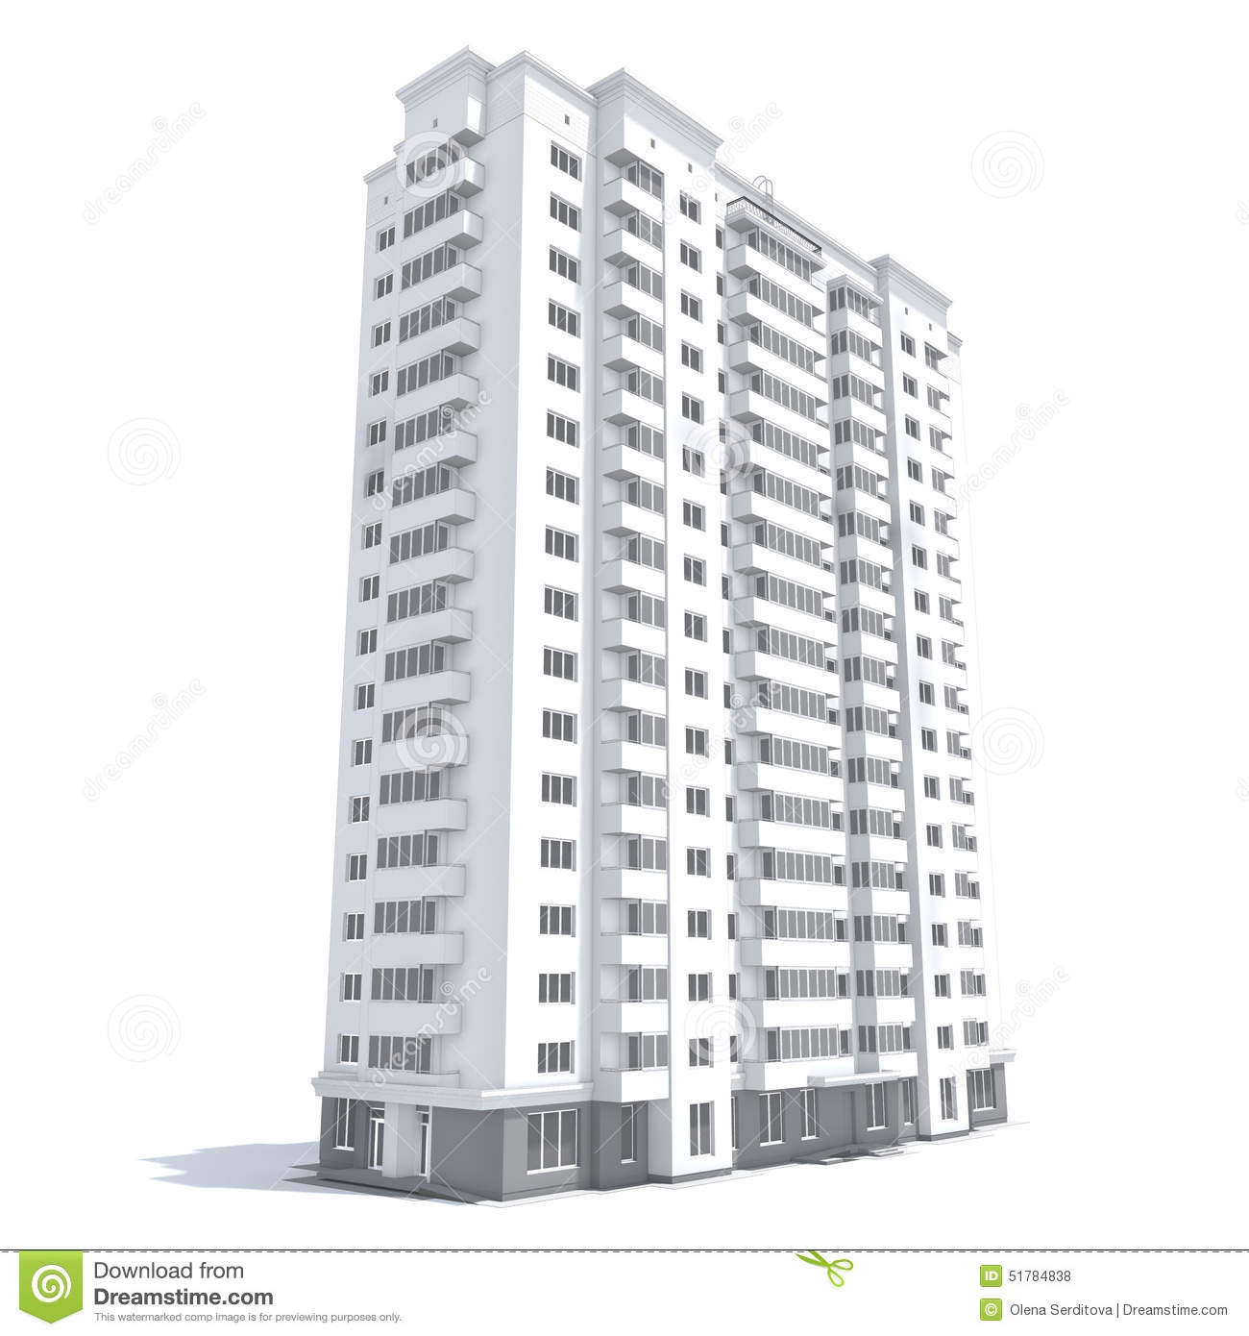
Building a house
Say, we have 4 workers building a house
Construction will be faster than if it would be done by 1 worker
After each floor, workers have to synchronize
Connect their parts - communication
Can‘t build 7th floor before 3rd

Slide 7
Amdahl‘s law
Speed-up of a parallel program/work:
f – is a fraction of the work that CAN be
done in parallel
n – number of parallel workers

Slide 8
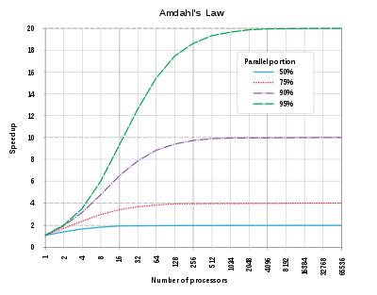
Amdahl‘s law implication

Slide 9
Weak and strong scalability
Scalability – the ability of hardware and software to deliver greater computational power when the amount of resources is increased.
Strong scaling measures how much the software is scalable when the problem size is fixed. => Amdahl's law.
Weak scaling measures how much the software is scalable when the problem size per processor is fixed => Gustafson's law.

Slide 10
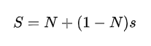
Gustafson‘s law
Speed-up of a parallel program/work:
s – is a fraction of the work that CANNOT be
done in parallel
N – number of parallel workers

Slide 11
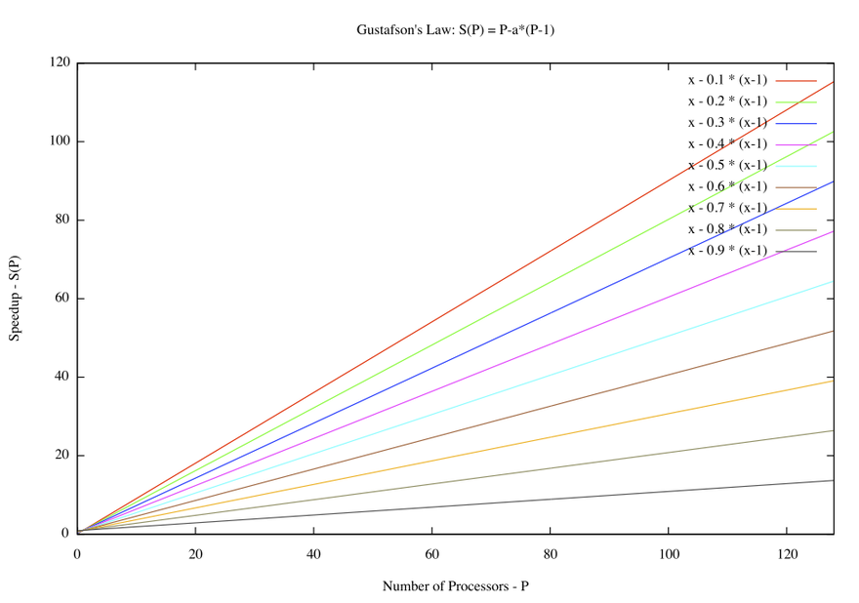
Gustafson's law implication

Slide 12
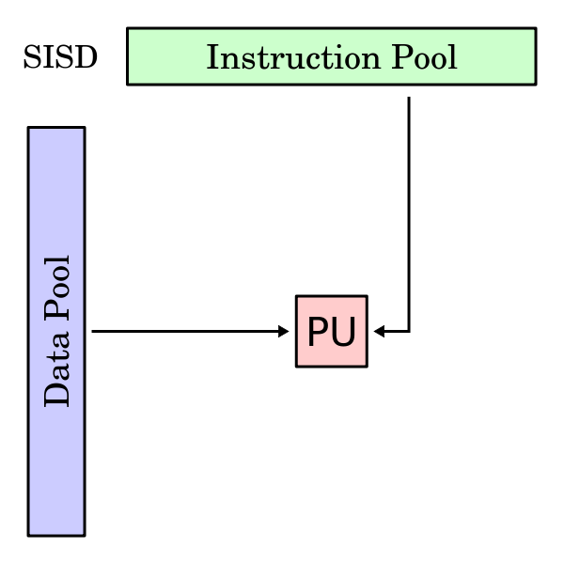
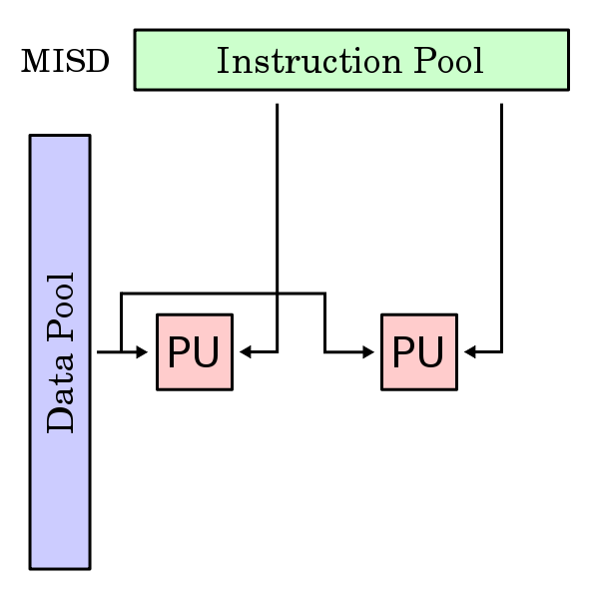
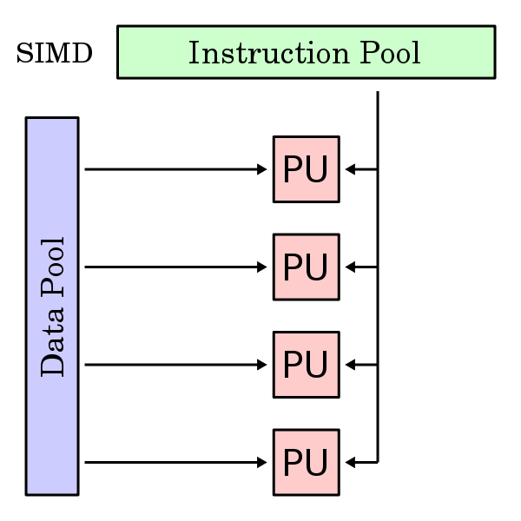
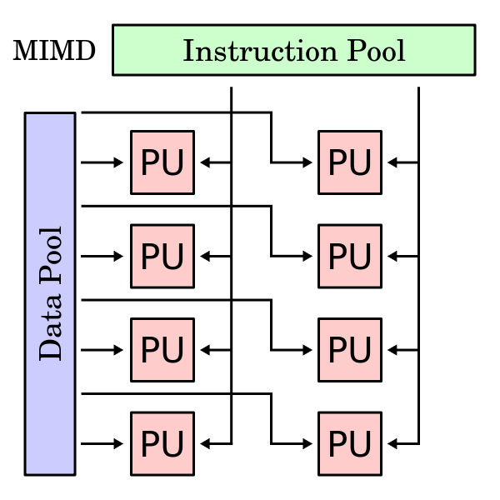
Flynn’s taxonomy

Slide 13
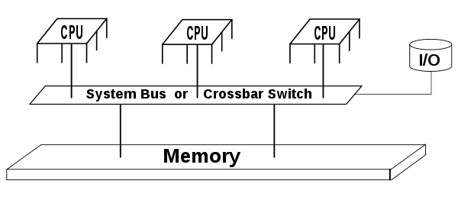
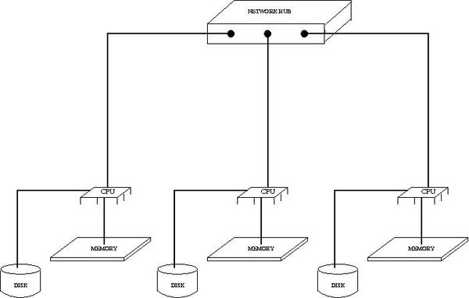
Shared memory and distributed memory
shared memory
distributed memory

Slide 14
Ways to work parallel
Scientific software (Matlab, Mathematica, ANSYS, OpenFoam, Tensorflow, PyTorch, etc)
Libraries (Math Kernel Library, CuDNN, CuBlas, Thrust, Boost)
Parallel instruments (OpenMP, MPI, Cuda, OpenCL)

Slide 15
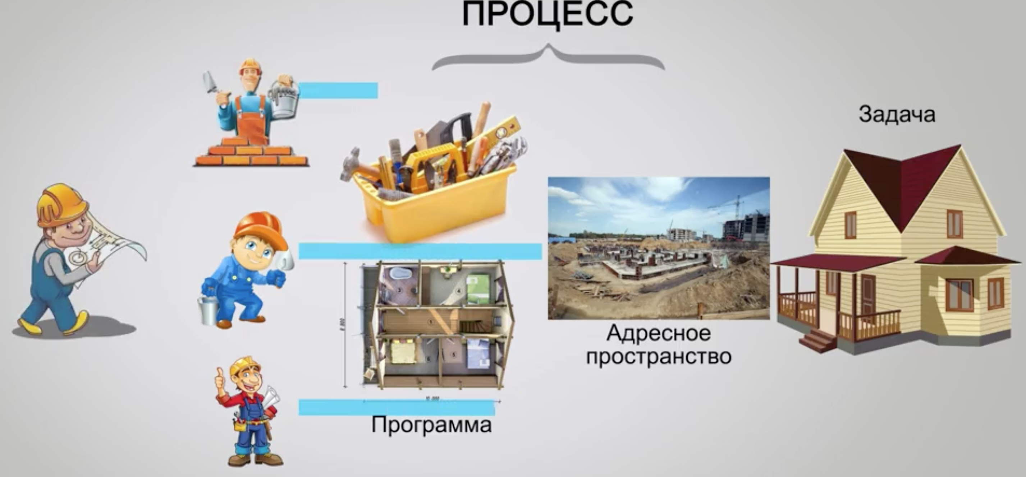
Shared memory systems: processes and threads

Slide 16
Shared memory systems: processes and threads
Threads
Process
Task
Address
space

Slide 17

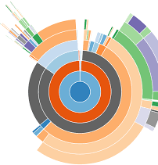
Profiling
Analysis of code that shows us show efficient our resource usage is.
Resource can be: CPU time, memory, network bandwidth, etc.
Today we focus on CPU time and memory.
There are a lot of visualizers.

Slide 18
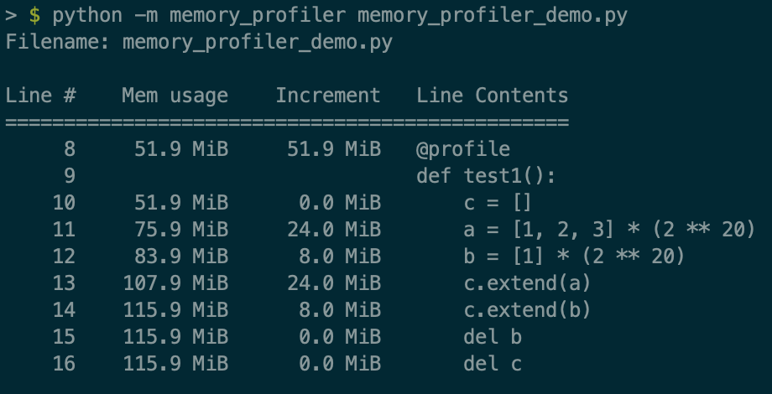
Memory profiling
Measures memory usage of the program. Understanding the memory usage characteristics of your code allows you to ask yourself two questions:
Could we use less RAM by rewriting this function to work more efficiently?
Could we use more RAM and save CPU cycles by caching?

Slide 19
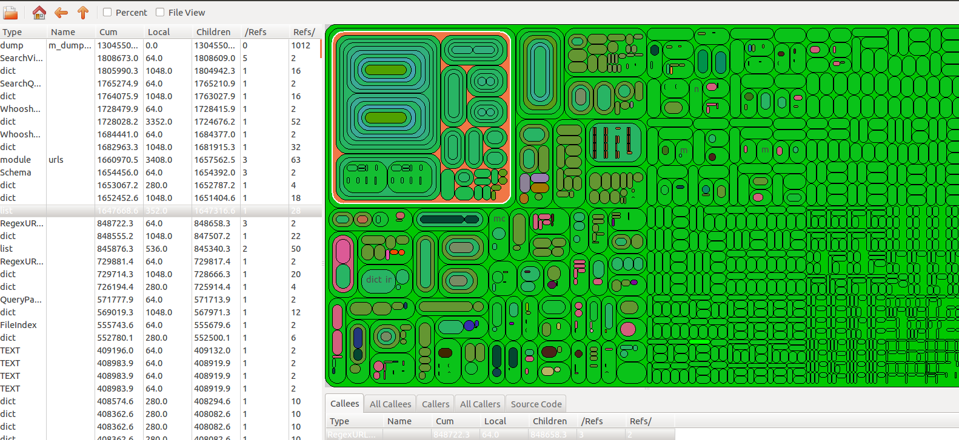
Time profiling
Measures time distribution among function calls of a program. Understanding the CPU time usage characteristics of your code allows you to ask yourself the following questions:
Can we identify suspicious functions that take too much computation time?
Can we optimize functions so that they would use less CPU computation time?

Slide 20
Profiling tools for python
CPU time profiling tools:
timeit
cProfile
line_profiler
Memory profiling tools:
memory_profiler
heapy

Slide 21
Exercises
Profile bifurcation map script from lecture 1:
use any of the disscussed profiling tools to see how much time each part of the script takes, also do memory profiling;
try varying different parameters ("n" and "m")
which parameters influence change the profiling configuration most?
Profile example script that performs spectography:
profile computation time of "get_spectography" function
can you find a way to increase the speed of the function?
Profile your own python code.

